Slide 1
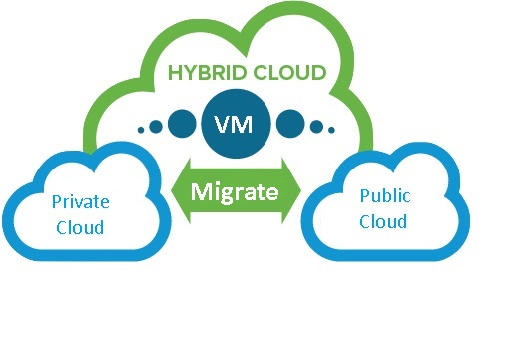
vSDA – Self Driving Hybrid Cloud Admin
Arun Viswanathan
Rijo Simon
Shubhangi Tandon
Advisors: Shenba Vishnubhatt, Tracy Lu, vROPS Team
Notes:
The purpose is to maintain this template for quarter to quarter. On some slides marked with * a quarterly update is expected, while the rest are on-need basis: If something changed, please change it and highlight it during your review presentation.
It’s not expected that you will always get through all the slides during the presentation. They will be distributed to the Innovation Council members beforehand, so please stay tuned for the deadline.
Keeping this deck up to date will benefit any new members joining the innovation council or showing interest towards the project. Please contact Martta Lystila mlystila@vmware.com for any questions or comments.

Slide 2
Our Goal
Develop a POC of Self-Driving Admin
Determine whether we need to scale up or scale down resources for a VM by finding patterns in past usage and predicting future usage.
On the basis of scale up/down needs, find a cost optimized cloud configuration on public/private cloud.
Notify and facilitate action on the recommendation through a popular communication channel (Slack).

Slide 3
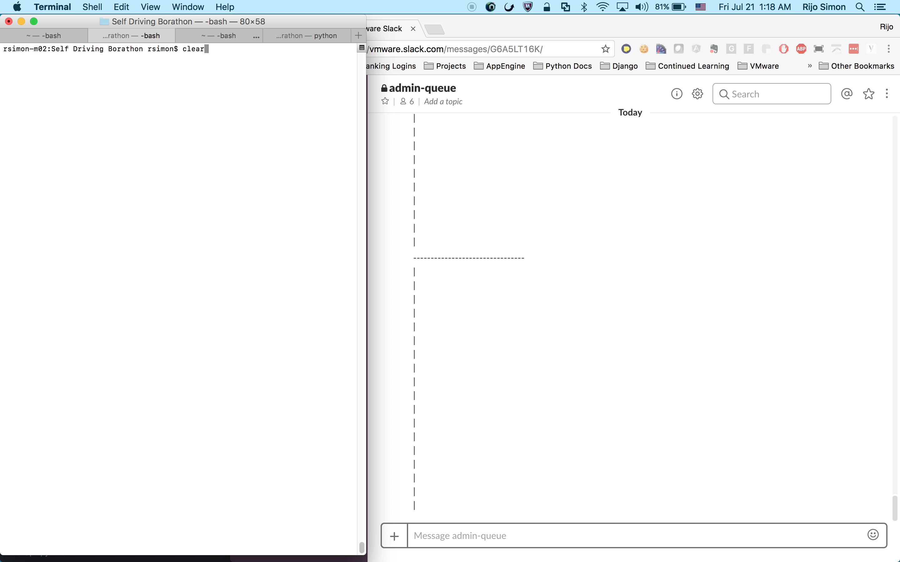
Demo
Present your demo!

Slide 4
Architecture
Data handling
Decision Making
Take Action
Classification
Algorithm
Train and Predict
Historic
Data
Slack Interface
Cloud
Optimizer
Updatepolicy
Data
Source

Slide 5
Challenges
Data
Generating training data and labels
Mocking test data
Pre-processing for Classification
Classification
Selecting the optimal classification algorithm
Resource allocation logic
Slack
Create an interactive notification , technology ramp up

Slide 6

Opportunity ($$$)
Savings with vSDA
Period to Period
25-30%
Over 3 Years
5, 000 VMs
OnPrem : $27M*
with vSDA : $21M*
Over 3 years save ~$6M*!!!
* Figure based on rudimentary market analysis

Slide 7
Next Steps
Improve on domain knowledge by interacting with customers, etc.
Holistic development of the application (better understanding of data, better algorithms and decision making logic, self healing etc.)
Roadshow for the POC within Vmware.
Find prospective products to integrate with. ( eg. vROPS, SDDC-aaS )
Partner with internal stakeholders to validate POC and measure cost-effectiveness.
Chart a business plan for the product.

Slide 8

Questions?

Slide 9

Thank You !

Slide 10
Appendix
1. Vmware TOC Calculator: Source for On Premise Cost.
2. Cloud vs On Premises: Source for cost difference between Public Cloud and On Premise

